Slide 1

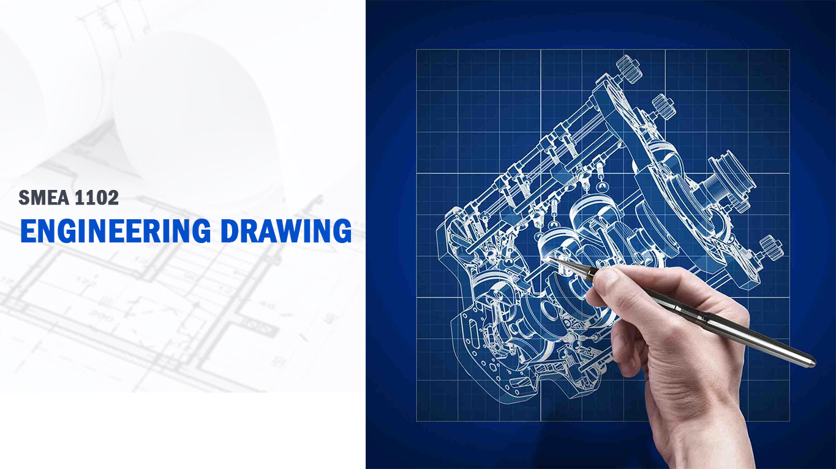
SATHYABAMA INSTITUTE OF SCIENCE AND TECHNOLOGY (DEEMED TO BE UNIVERSITY) Accredited with Grade “A” by NAAC
Prof. R. DEVARAJ
DEPT OF MECH ENGG
E-Mail: r_devaraj67@yahoo.com

Slide 2
SATHYABAMA INSTITUTE OF SCIENCE AND TECHNOLOGY (DEEMED TO BE UNIVERSITY) Accredited with Grade “A” by NAAC
Assisting Faculty for A1:
1. Prof. Britto Joseph (Mech)
(brittojoseph.mech@sathyabama.ac.in)
2. Prof. Dileep Kumar Sahoo (Auto)
(dillipkumarsahoo@gmail.com)

Slide 3
SATHYABAMA INSTITUTE OF SCIENCE AND TECHNOLOGY (DEEMED TO BE UNIVERSITY) Accredited with Grade “A” by NAAC
Assisting Faculty for D1:
1. Prof. Deepak J (Prod)
(deepakcape@gmail.com)
2. Prof. Karthikeyan P (Auto)
(kksivakodi@gmail.com)

Slide 4
SMEA1102 ENGINEERING DRAWING L T P Credits Total Marks
1 0 4 3 100
COURSE OBJECTIVES
To know the basics of Engineering Graphics.
To make the student to possess the efficient drafting skill.
To make the students to understand the importance of sectioning and concept of development.
To learn about the orthographic and pictorial projections.
END SEMESTER EXAMINATION QUESTION PAPER PATTERN
Maximum Marks: 100 Exam Duration: 3 Hrs
PART A: Questions from each unit, each carrying 2 marks 20 Marks
PART B: Questions from each unit with internal choice, each carrying 16 marks 80 Marks

Slide 5
TEXT / REFERENCE BOOKS
Engineering drawing practice for schools and colleges, SP 46 – 1988. (http://web.iitd.ac.in/~achawla/public_html/201/lectures/sp46.pdf).
Natarajan, K.V., A Text Book of Engineering Graphics, Dhanalakshmi Publishers, 21st Edition, 2012.
Bhatt, N.D., Engineering Drawing, Charotar Publishing House, 53rd Edition, 2014.
Venugopal, K., Prabhu Raja, V., Engineering Graphics, New Age International Publishers, 15th Edition, 2018.

Slide 6
CHAPTERS
UNIT 1 LETTERING, DIMENSIONING AND GEOMETRICAL CONSTRUCTION 9 Hours BIS - Lettering - Two systems of dimensioning - Dividing a straight line into any number of equal parts - Bisecting an angle and right angled triangle - Drawing a regular pentagon and hexagon given one side - Conic sections - ellipse, parabola, hyperbola by eccentricity method.
UNIT 2 PROJECTION OF POINTS AND LINES 9 Hours
Projection - Types of projection - Projection of points lying in four quadrants - Projection of lines (First angle projection only) - Projection of lines parallel and inclined to one or both the planes.
UNIT 3 PROJECTION OF SOLIDS 9 Hours
Projection of simple solids like prisms, pyramids, cylinder, cone with its axis perpendicular to HP, axis perpendicular to VP, axis inclined to HP.
UNIT 4 SECTION OF SOLIDS 9 Hours
Purpose of sectioning - Sectional views - Hatching - Section plane perpendicular to one plane and parallel to other plane - Section plane inclined to HP - Section plane inclined to VP - True shape of the section.
UNIT 5 DEVELOPMENT OF SURFACES AND ORTHOGRAPHIC PROJECTION 9 Hours
Need for development of surfaces - Types of development of surfaces - Development of pentagonal and hexagonal prisms - Development of cylinders - Development of pentagonal and hexagonal pyramids - Development of cones. Orthographic Projection - Free hand sketch –conversion of 3D into 2D.

Slide 7
UNIT 1
LETTERING, DIMENSIONING AND GEOMETRICAL CONSTRUCTION 9 Hours
BIS - Lettering - Two systems of dimensioning - Dividing a straight line into any number of equal parts - Bisecting an angle and right angled triangle - Drawing a regular pentagon and hexagon given one side - Conic sections - ellipse, parabola, hyperbola by eccentricity method.
INTRODUCTION
Who is an Engineer?
An Engineer is a
creative,
innovative and
productive person
Just as people in society have language to communicate, WE Engineers use drawing to communicate.
Drawing is the language of Engineers.
Engineering drawing is a universal and powerful language.

Slide 8
Engineering student/Engineer can
design an object
visualize how it will look when made
make a drawing of it and
use this drawing as a means of communication to the production team to make this product.
ENGINEERING DRAWING
Engineering drawing is a drawing
drawn by an engineer,
having engineering knowledge,
for the engineering purpose.
IMPORTANCE OF ENGINEERING DRAWING
An Engineer must have perfect knowledge and skill in drawing.
As the bad language is unpleasant to read and communicate, so also an incorrect drawing is a discomfort for a trained eye.
Even a small error committed by the draughtsman will misguide the machinist and the ultimate product will be a failure.

Slide 9
Engineering Drawing
Manual Drawing
CADD
Computer has a major impact on the methods used to design and create technical drawings.
Design and drafting on computer are cheap and less time consuming.

Slide 10
DRAFTING TOOLS
Drawing Board
Mini Drafter
Drawing Sheet (A2)
Pencils (HB, H, 2H, 4H, 2B, 4B etc.,)
Non-dust Rubber
Scales (Civil Engineer's Scale, Architect's Scale, Metric Scale)
Instrument Box
Set Squares (30°, 45°, 60° etc.,)
Drawing Board Clips, Clamps, Pins and Cello Tape
Protractor / Pro Circle / Circle Master / French Curve
Pencil Sharpener
Small paper knife or Stitching thread etc.,

Slide 11
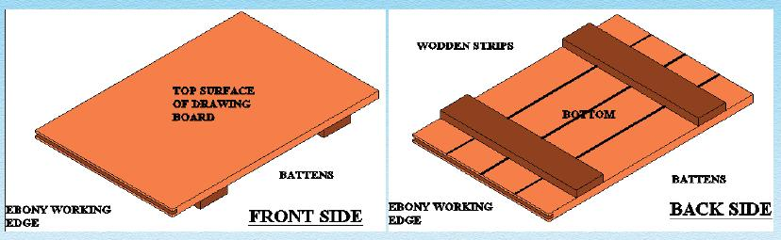
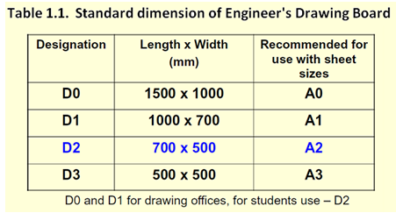
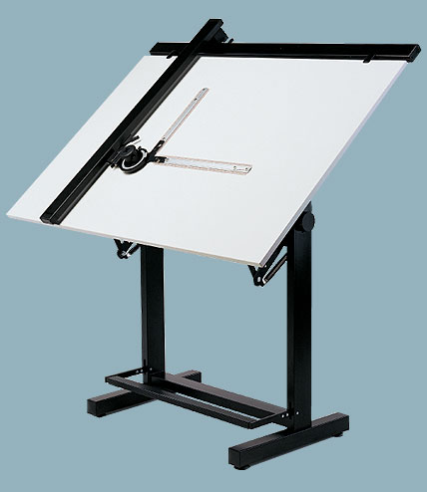
DRAWING BOARD
Drawing board is made of soft wooden platens.
Almost perfect planning of the working surface of the drawing board is to be ensured.

Slide 12
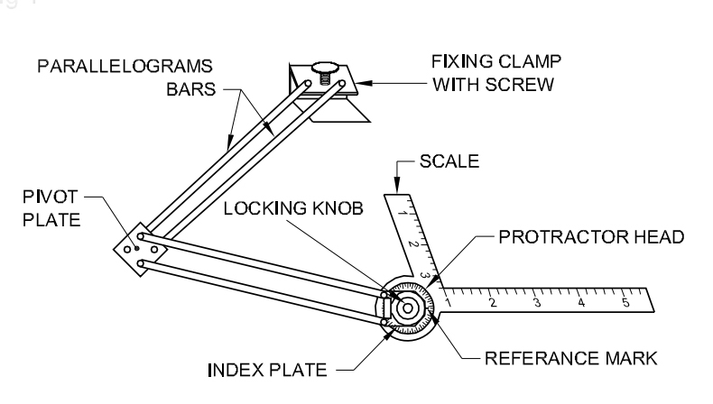
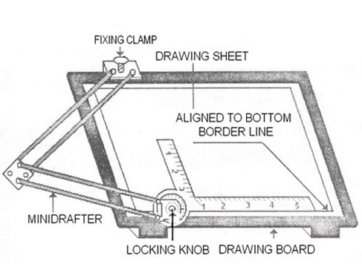
MINI DRAFTER
This is a device used to draw parallel or inclined lines very effectively with ease.
This is mounted on the top left corner of the drawing board by means of a clamping mechanism which is an integral part of the device.
An L-shaped scale which is graduated in millimeters acts as the working edge of the mini-drafter.
The L-Shaped scale also has a degree scale for angle measurement.
The working edge can be moved to any desired location on the drawing board.

Slide 13
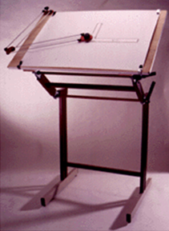
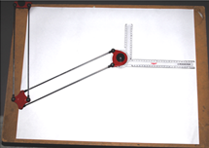
PROCEDURE FOR CLAMPING THE MINI DRAFTER
Set the protractor head with reference mark indexing zero degree, then fix the clamp of the mini-drafter at the top left corner either along the top horizontal edge of the board or along the left vertical edge of the board.
With the drawing sheet placed underneath the scales of the mini-drafter, fix the drawing sheet to the drawing board with the scales of the mini- drafter aligned either with the vertical or the horizontal borderlines of the drawing sheet.

Slide 14
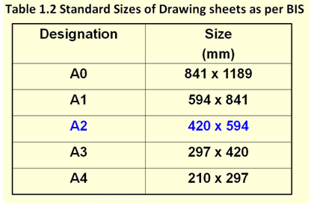
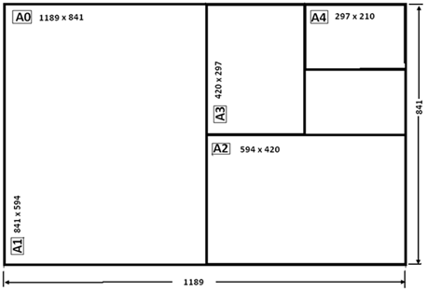
Drawing sheet is the medium on which drawings are prepared by means of pencils or pen.
Drawing sheets are available in standard sizes as shown in Table 1.2.
A standard A0 size sheet is the one with an area of 1 m² and having dimensions of 1189 x 841.
Each higher number sheet (A1, A2, A3, etc. in order) is half the size of the immediately lower numbered sheet.
For drawing practice for first year engineering students A2 size is the preferred drawing sheet.
The recommended sizes obtained for various drawing sheets are shown.
DRAWING SHEET

Slide 15
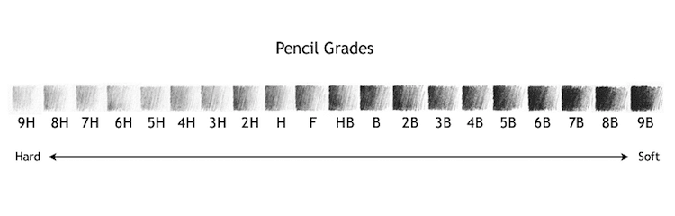
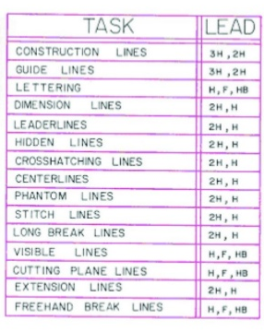
PENCILS / LEAD STICKS/ PENCIL SHARPENER / ERASER
The primary tool used in technical drawings is the pencil or lead sticks.
Generally for technical drawings, the three grades of pencil used is HB, H and 2H.
For different purposes, different grades of pencils are used.
The HB pencil is a soft grade used for drawing thick lines, borderlines, lettering and arrowheads.
The H pencil is a medium grade used to draw finishing lines, visible lines and hidden lines.
The 2H pencil is a hard grade pencil used for drawing construction lines, dimension lines, center lines and section lines.
Pencil sharpener is used to mend the pencils.
Eraser is used to erase the unnecessary part of the pencil drawing.

Slide 16
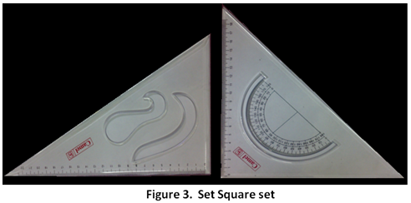
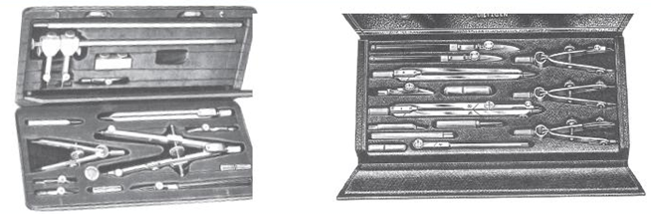
SET SQUARES
Set squares are a set of 45° set square and 30°-60° set-square, as shown in figure 3.
They are used in conjunction with each other and with T-square to draw parallel, inclined and perpendicular lines.
They are made of transparent acrylic.
Each is having beveled edges with engraved mm or inch marking.
The 45° set square generally has a protractor where as the 30°-60° set-square includes French curves.
INSTRUMENT
BOX

Slide 17
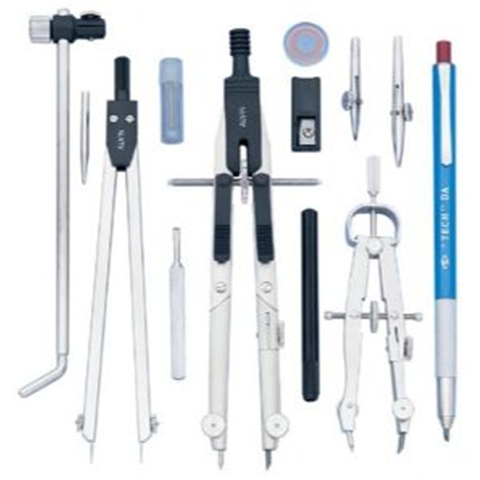
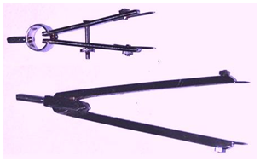
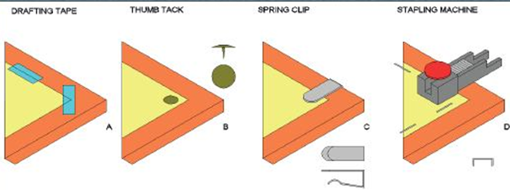
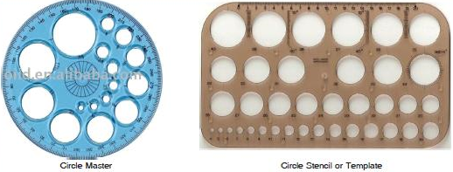
COMPASSES
These are used to draw arcs or circles.
Generally two sizes of compasses: one large compass and the other a small spring bow compass are commonly used.
DIVIDER
Dividers are used to transfer lengths to the drawings either from scales or from the drawing itself.
Similar to the compasses, two sizes of dividers are used in technical drawings: One large divider and the other small spring bow divider.
DRAWING CLIPS AND CLAMPS
CIRCLE MASTER OR PRO-CIRCLE

Slide 18
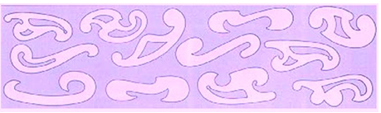
FRENCH CURVE
French curve is free form template made of acrylic
It is used to draw a smooth curve passing through a number of points.
The outer profile of the French curve is adjusted such the smooth curve passes through more than three points and a curve passing through these lines are drawn.

Slide 19
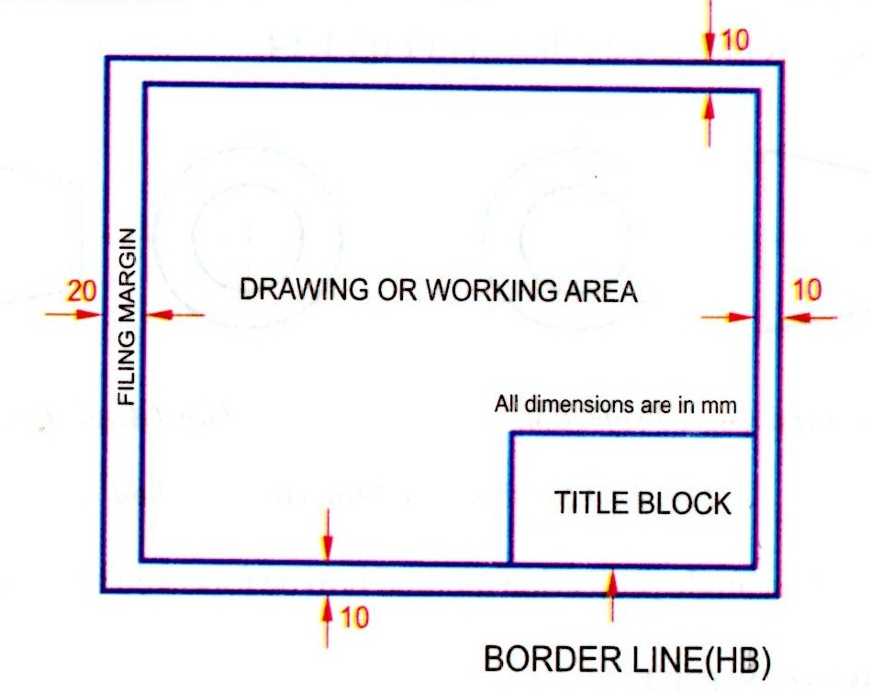
LAYOUT OF DRAWING SHEETS
Any engineering drawing has to follow a standard format.
The drawing sheet consist of drawing space, title block and sufficient margins.
After fixing the drawing sheet on the drawing board, margins must be drawn.

Slide 20
TITLE BLOCK
An important feature which is a must in every drawing sheet.
The title box is drawn at the bottom right hand corner of every drawing sheet and provides technical and administrative details regarding the drawing/component.
Though there are various dimensions for the title box, for Engineering students it is advisable to use a title box of size 170 mm x 65 mm.
A typical title block is divided into two zones:
(a) part identification zone and
(b) additional information zone.

Slide 21
TITLE BLOCK
In the part identification zone:
information like the component identification number,
name of the part,
the legal owner of the drawing (i.e. the name of firm/component/etc., will be highlighted.
In the additional information zone:
technical information like symbols,
indicating the system of projection,
scale of drawing,
method of indicating surface texture,
geometric tolerances, etc., will be highlighted.

Slide 22
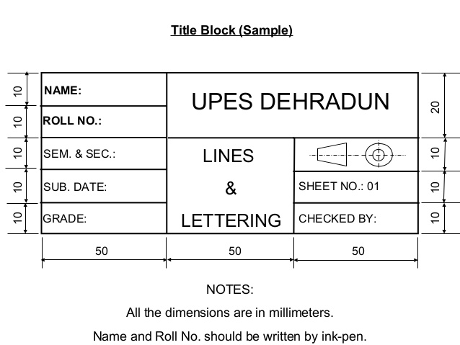
TITLE BLOCK

Slide 23
LETTERING
Writing of titles, sub-titles, dimensions, scales and other details on a drawing is called Lettering.
The Indian standard followed for lettering is BIS: 9609
Essential features of ‘Lettering’:
Legibility
Uniformity
Ease
Rapidity
Suitability for microfilming/photocopying/any other photographic processes.
Single stroke lettering is used in engineering drawing – width of the stem of the letters and numerals will be uniformly thick equal to thickness of lines produced by the tip of the pencil.
Single stroke does not mean – entire letter written without lifting the pencil/pen.
Letters are classified as: Single stroke letters and Gothic letters.

Slide 24
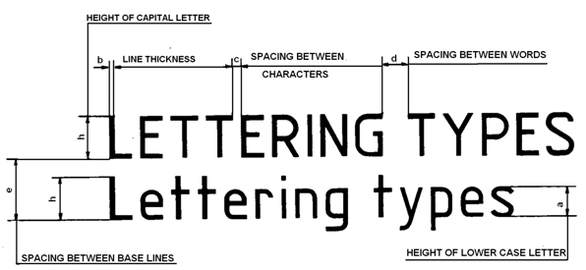
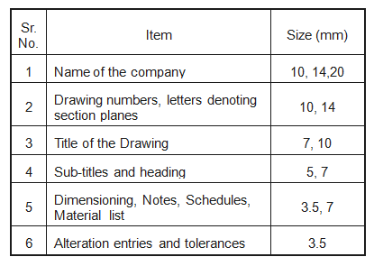
LETTERING
Types of Lettering: Vertical Lettering and Inclined Lettering.
Size of letters are designated by height of CAPITAL LETTERS.
The letter sizes recommended for various items

Slide 25
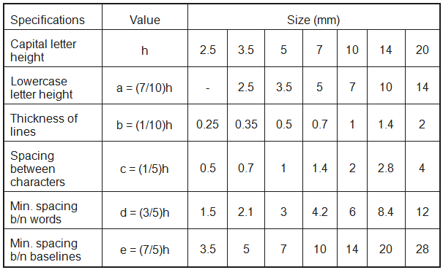
LETTERING
Width of characters = (5/6)h
Submit your answers in PDF to:
CSE A1:
brittojoseph.mech@sathyabama.ac.in
dillipkumarsahoo@gmail.com
CSE D1:
deepakcape@gmail.com
kksivakodi@gmail.com
Ex. 1. (Maximum Marks = 10 / Use A2 size drawing sheet)
Write the capital letters, A to Z, using the following dimension:
Height of the capital letter = 10 mm
Width of the letter = 8 mm
Spacing between letters = 2 mm

Slide 26
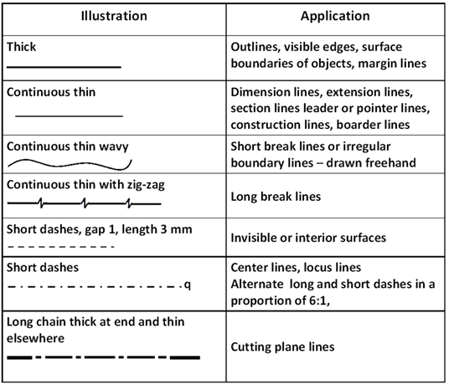
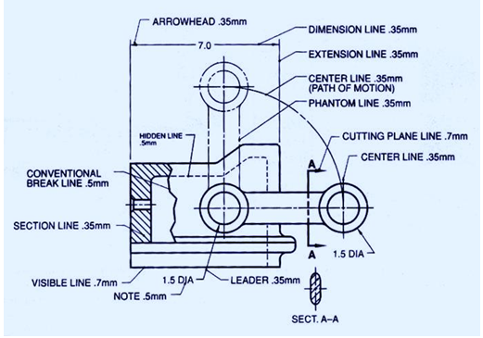
LINES
Lines are one important aspect of technical/engineering drawing.
Lines are always used to construct meaningful drawings.
Various types of lines are used to construct drawing, each line used in some specific sense.
Lines are drawn following standard conventions mentioned in BIS (SP46:2003).
A line may be curved, straight, continuous, segmented. It may be drawn as thin or thick.
A few basic types of lines widely used in drawings are shown in the following Table.

Slide 27
DIMENSIONING

